Slide 1

Translating Under the Influence
Translation Theory for the Translation Workshop/ Studio

Slide 2
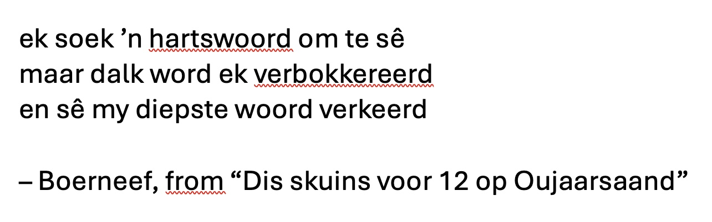

Slide 3
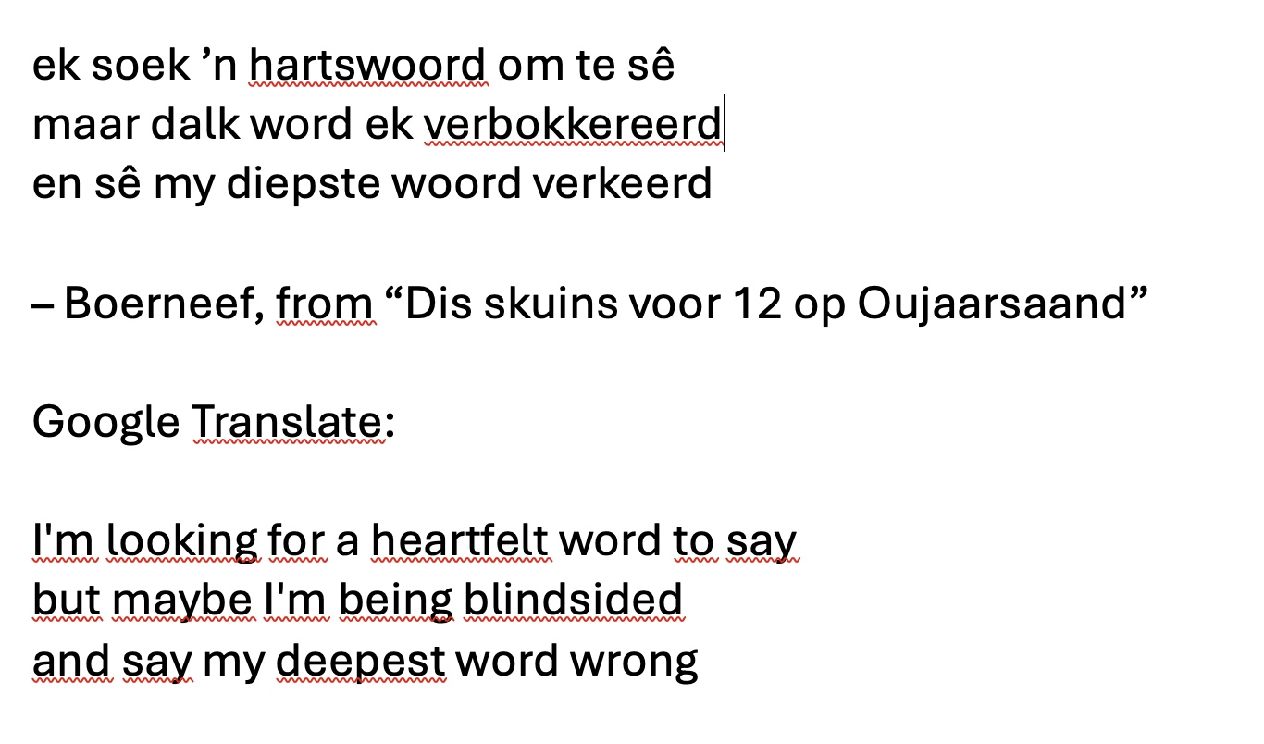

Slide 4
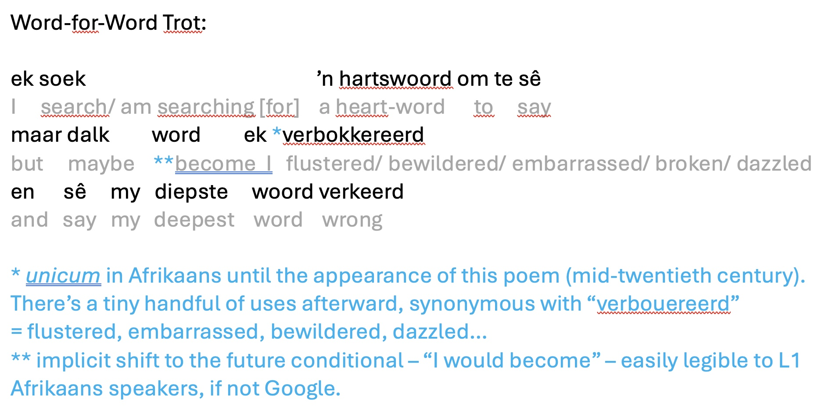

Slide 5
Snippets of “Translation Theory”
“Punctuate the translation; don’t translate the punctuation”
– Danny Hahn
“If the translator is to do justice to himself/herself as a reader, if the translator is to become the creative writer of his/her reading, then the language of translation must be equal to the translator's perceptual experience of, and bodily responses to, source texts.”
– Clive Scott
“Translation is the most intimate act of reading. I surrender to the text when I translate.”
– Gayatri Chakravorty Spivak
“If you are going to build a homemade grenade, you better everything exactly right. [But] translation necessitates compromise between the demands of the original poem and the demands of the new language.”
– Adam Sol

Slide 7
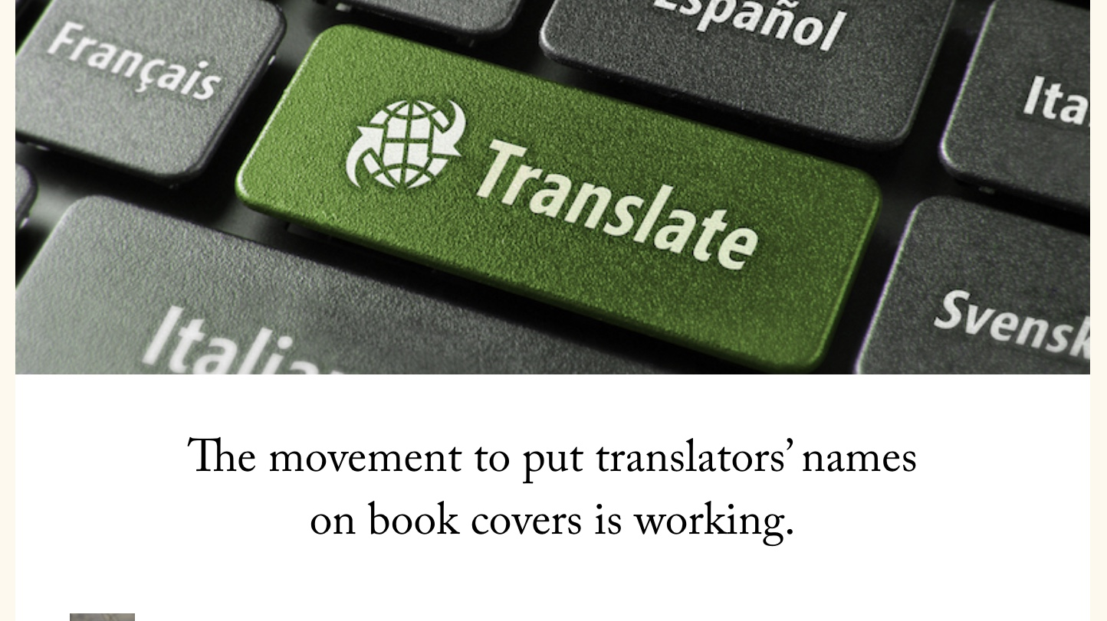
Bolstering/ Promoting/ Celebrating the Translator’s Agency?

Slide 8

Bolstering/ Promoting/ Celebrating the Translator’s Agency?

Slide 9
Bolstering/ Promoting/ Celebrating the Translator’s Agency?
UNDERCONFIDENCE
& (defensive)
OVERCONFIDENCE

Slide 10
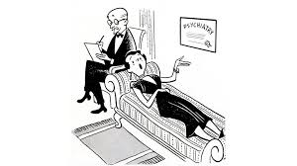

Bolstering/ Promoting/ Celebrating the Translator’s Agency?
UNDERCONFIDENCE
& (defensive)
OVERCONFIDENCE

Slide 11

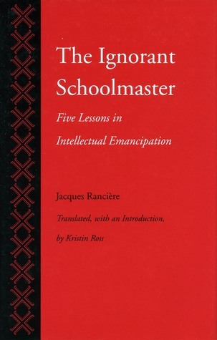
Bolstering/ Promoting/ Celebrating the Translator’s Agency?

Slide 12
Bolstering/ Promoting/ Celebrating the Translator’s Agency?
Risk of THEORY becoming the new MASTER

Slide 13
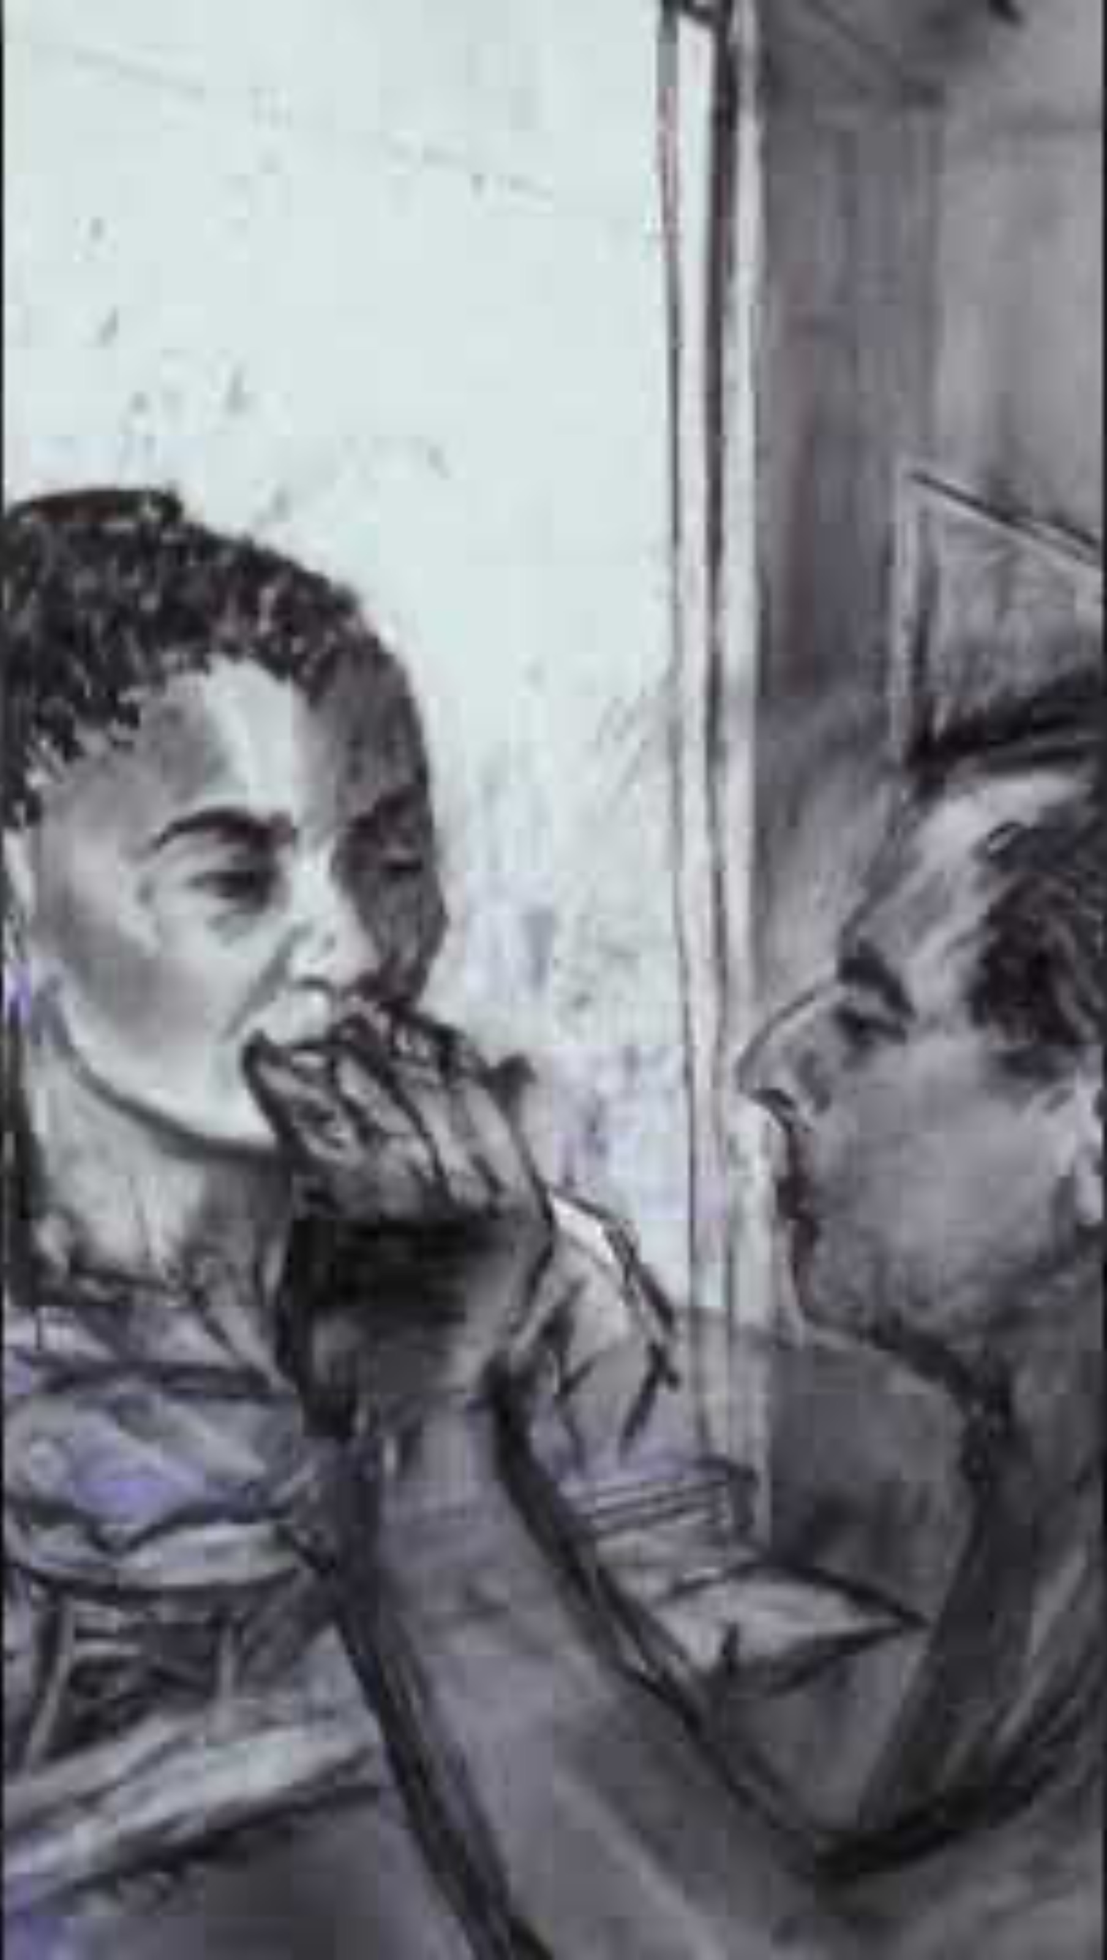
Uncertainty,
Muddle, Improvisation, Openness, the Less Good Idea, and you never know what theory will be useful…

Slide 14
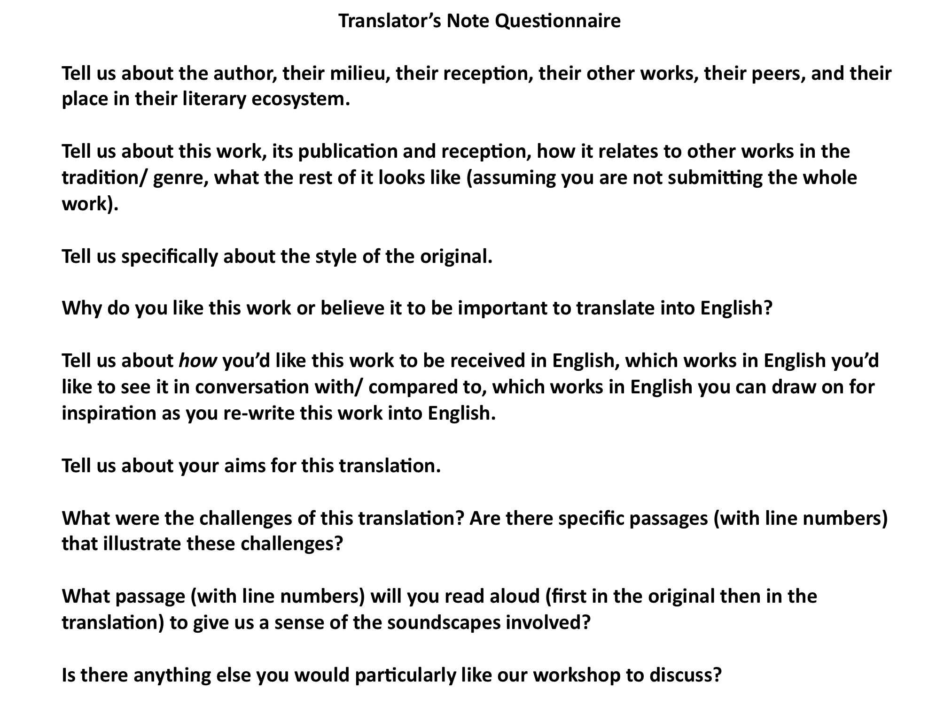
In the Workshop…

Slide 15
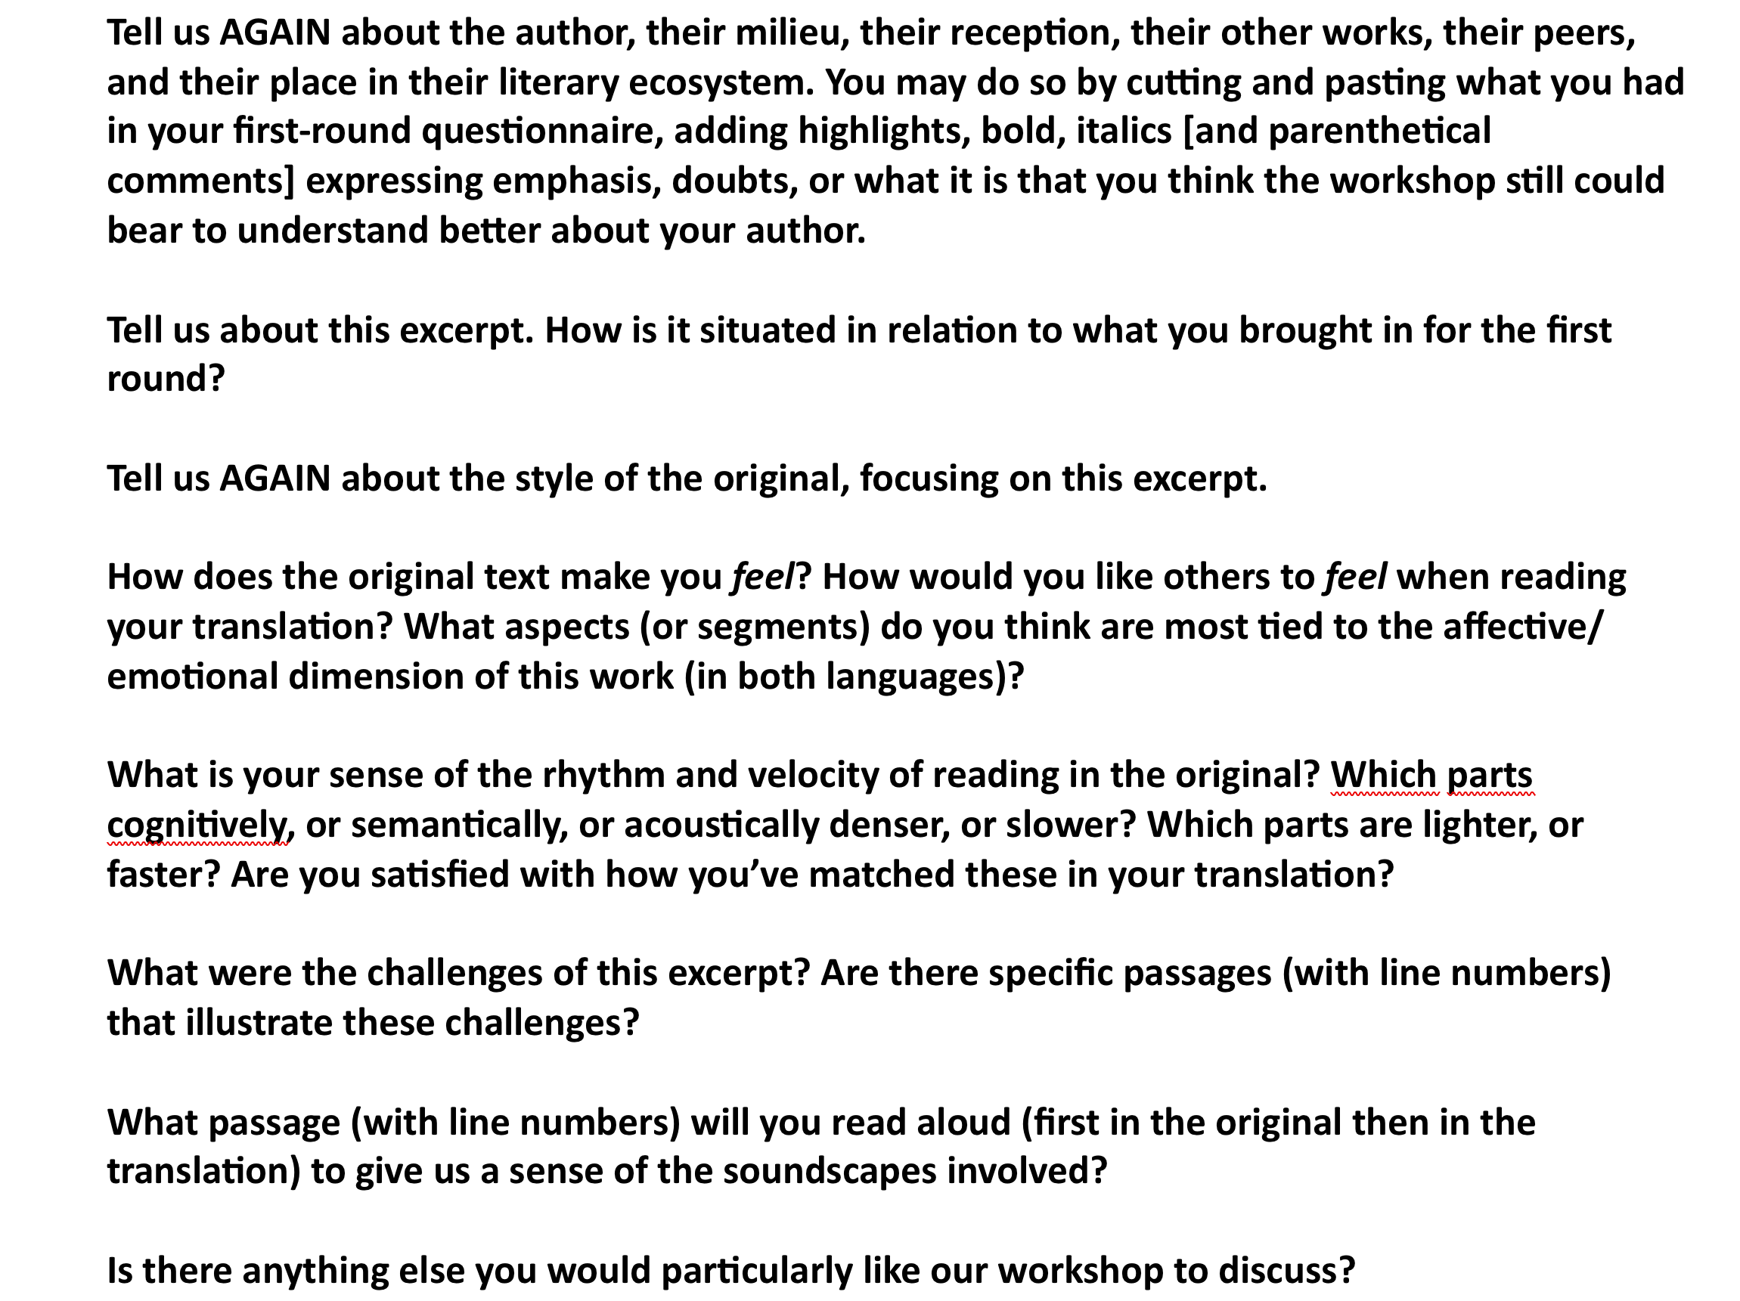
Round 2 …

Slide 16
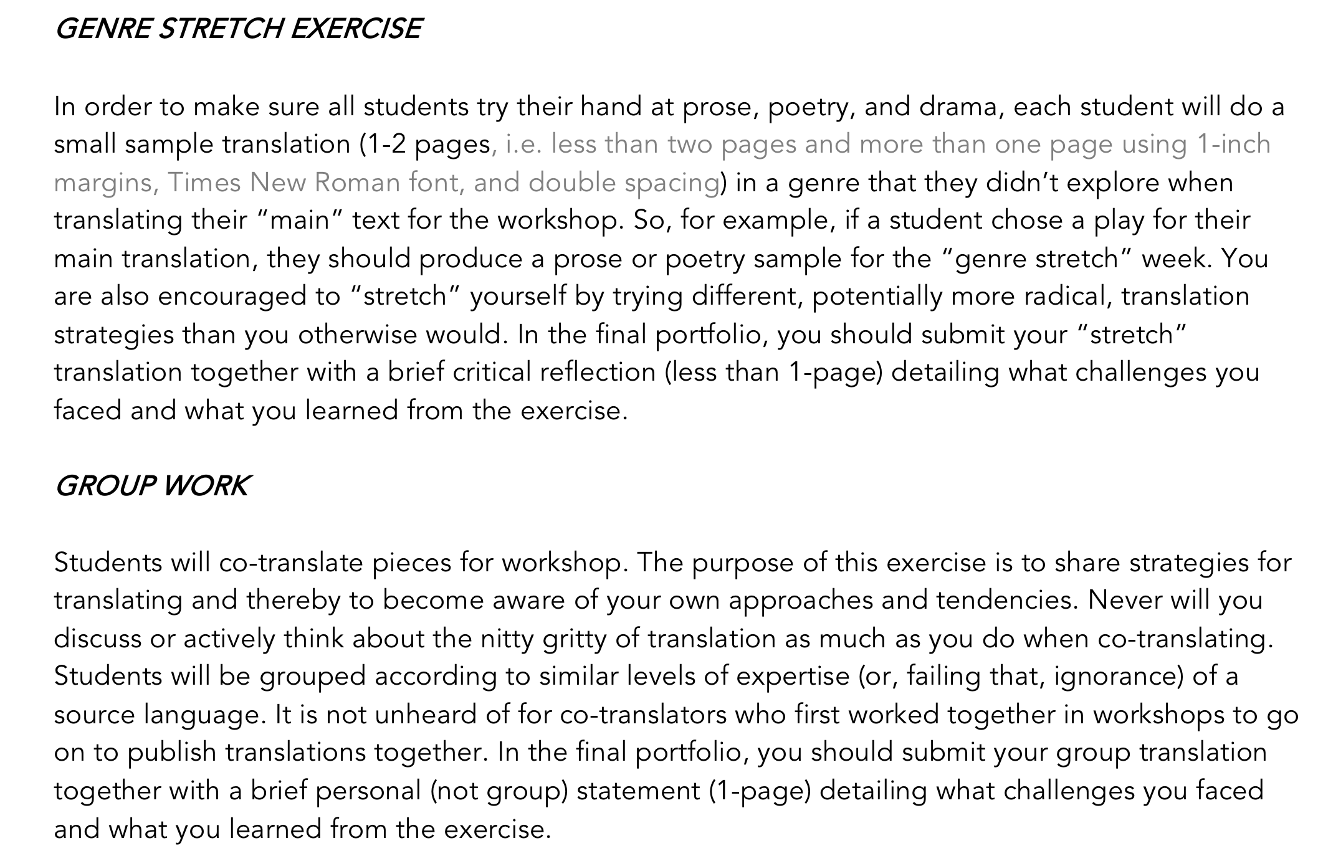

Slide 17
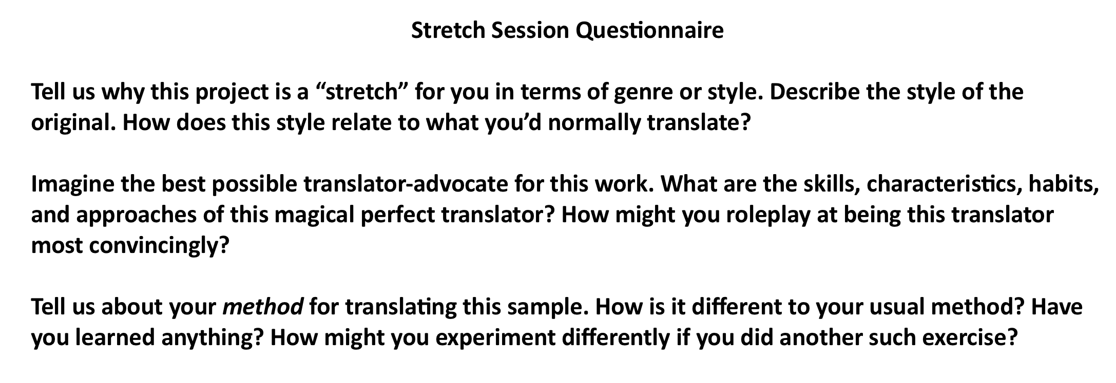

Slide 18
So, given the end-goal of sustainable creative uncertainty and an appropriate level of confidence in literary translation workshop, what are the roles of Translation Theory?

Slide 19
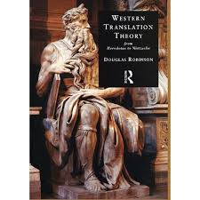
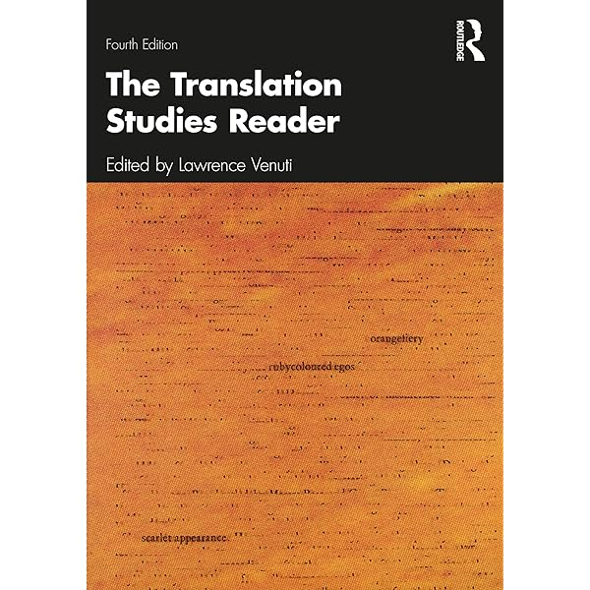
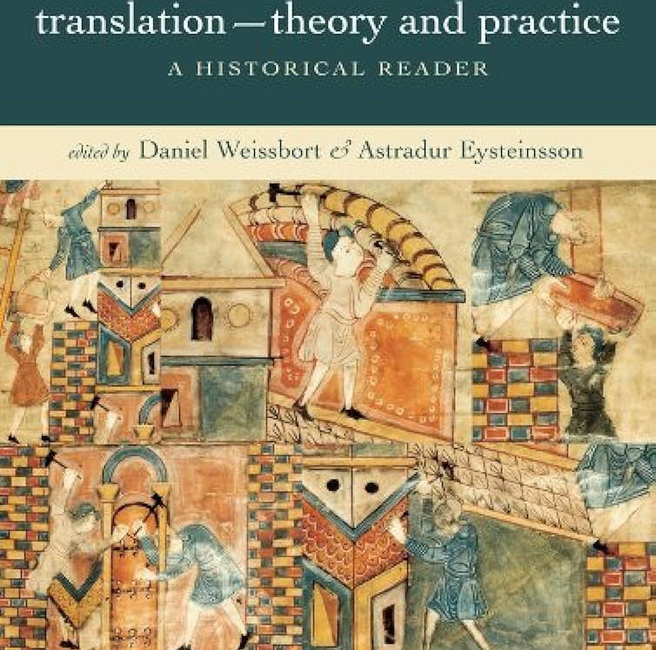

1) A Literary Translation Theory Canon?

Slide 20
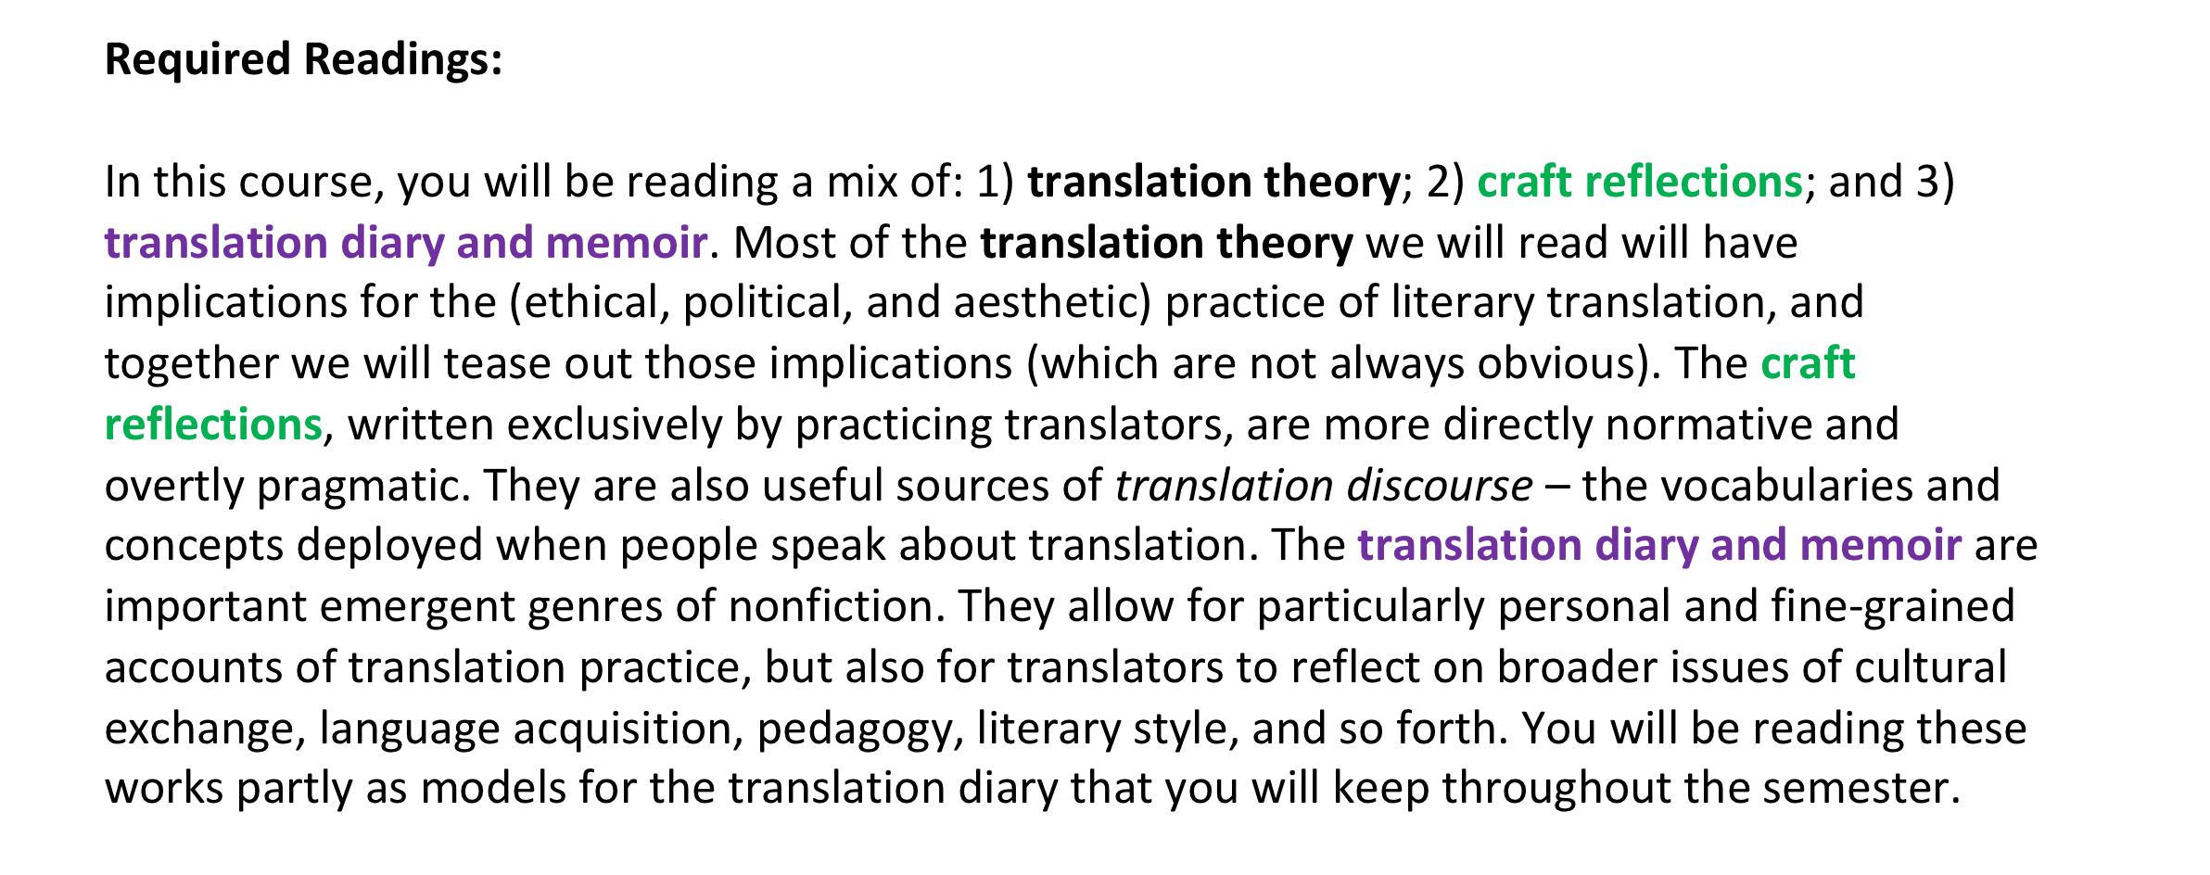

Slide 21
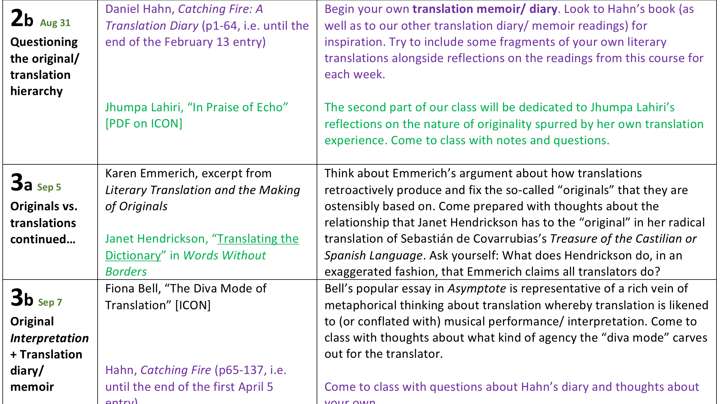

Slide 22

The proverbial “bar at the ALTA conference”…

Slide 23

2) Translation Theory for Future Translation Studies Scholars

Slide 24
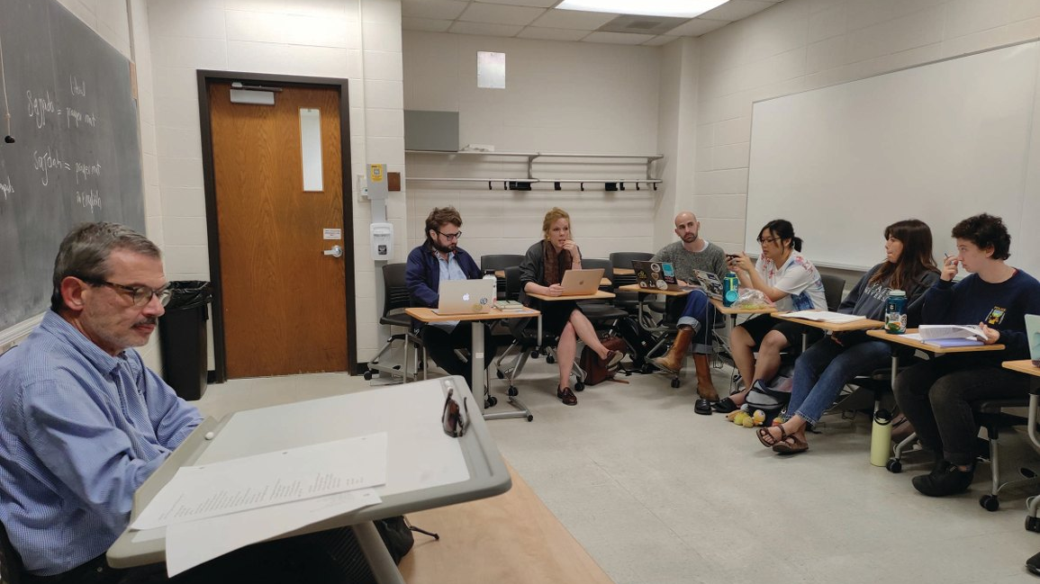
3) Translation Theory for Emergent Literary Translators
(a resource for the less good idea)

Slide 25
Resistance to Theory
[…] those looking for a flashy new theory need not bother reading any further: there are plenty of them out there, from the prescriptive to the prohibitive (not to mention the plainly abstruse), and I don’t intend to add to the noise. Consider this rather an “antitheory,” or perhaps just a common-sense approach. I’m aware that common sense isn't nearly as exciting as taking an extreme position. But having perused a number of extreme positions, I’ve found them not of much use when it comes to looking at what translation is […] and many of them aren’t even very exciting brain teasers.
Mark Polizzotti, Sympathy for the Traitor: A Translation Manifesto (2018)

Slide 26
I want to encourage […] colleagues to take a fresh look at “The Task of the Translator” and then decide for themselves whether they want their own students to reproduce the argument—or rather, which of the many contradictory and incompatible observations and assertions that can be found in the essay they wish their students to absorb. For nobody could seriously want a student to end up as muddled about translation as Benjamin was.
– David Bellos, “Halting Walter” (2009)

Slide 27
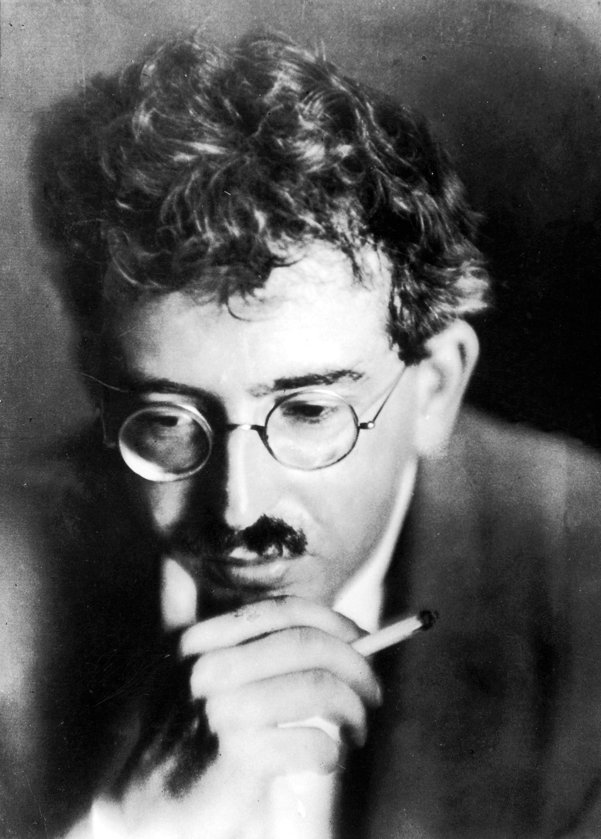
Halting Walter
Faltering with Walter

Slide 28
For each of your two TUI assignments, you will choose a prose passage or a short poem to translate twice: once as you would normally, and the second time while “under the influence” of a theorist covered in the course. Be bold, be adventurous, be inventive. We will discuss your translations in class. Please be sure to include either a translator’s note or a significant passage in the assignment that discusses which theorists your translation is “influenced” by and how.
For

Slide 29
& writing about it…

Slide 30
Your TRANSLATION SELF-WRITING project (25%) is an exercise in developing your voice as a translator – your sense of how you translate, why you translate, and where you place yourself in relation to the theoretical and critical traditions we encounter together in this course.
Take your formal and tonal cues from the published examples of translatorly self-writing we read together. Consider which nonfictional form – diary, essay, memoir, hybrid – best serves your particular self-writing project. One of the things those models make clear is that writing about translation can be at once deeply personal and addressed to a larger public: it is also a form of translation advocacy, a way of making visible work that too often remains invisible. Write with that possibility in mind.
The project may include translation drafts and commentary. It may include thoughts about translation from outside the immediate context of our course, provided you arrive at them during the semester. It may be text or audio – your choice.
I expect consistent progress (even if this means false starts and provisional conclusions). You will submit a sample of your work every three weeks for comments – but no grade – as a check-in on that progress. The final project will be submitted during exam week.

